Slide 1

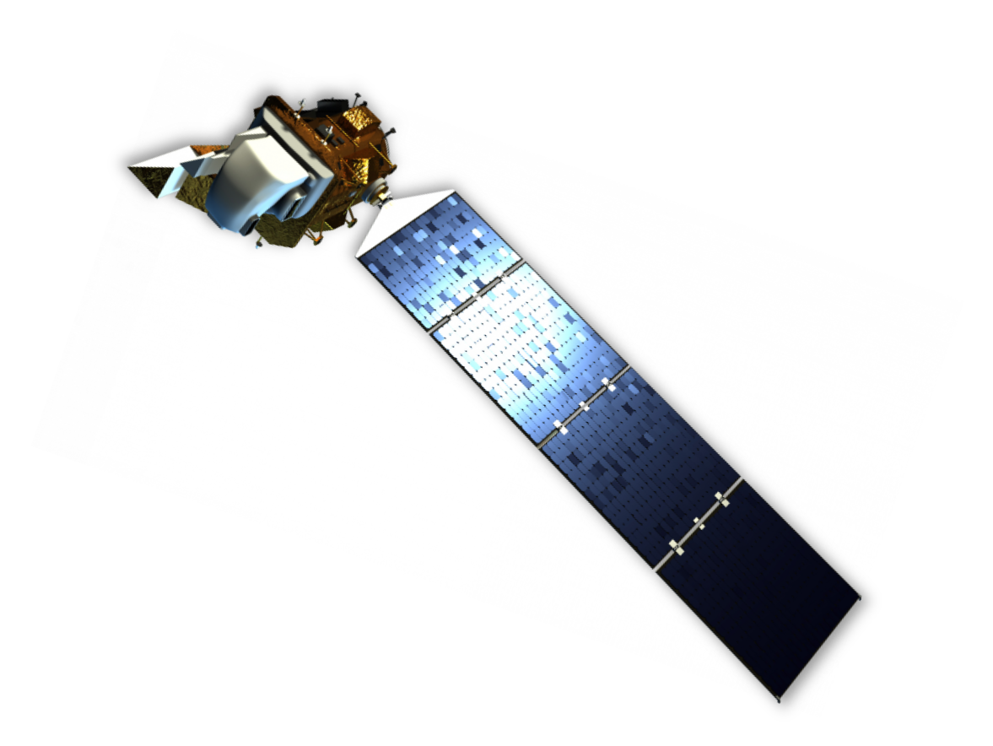
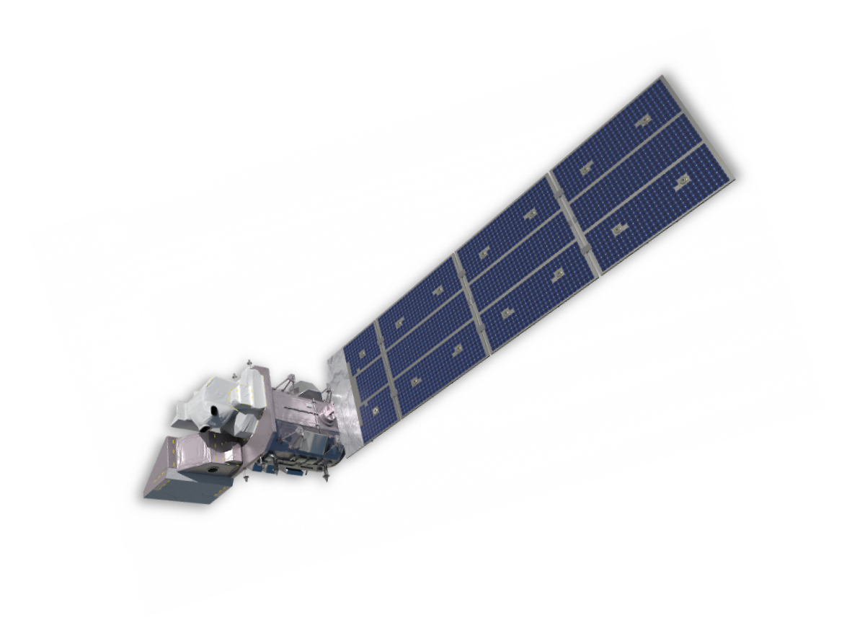
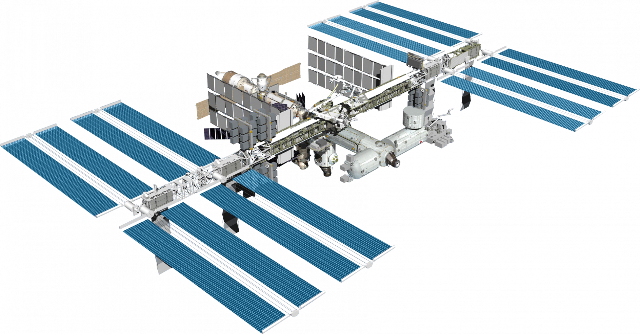












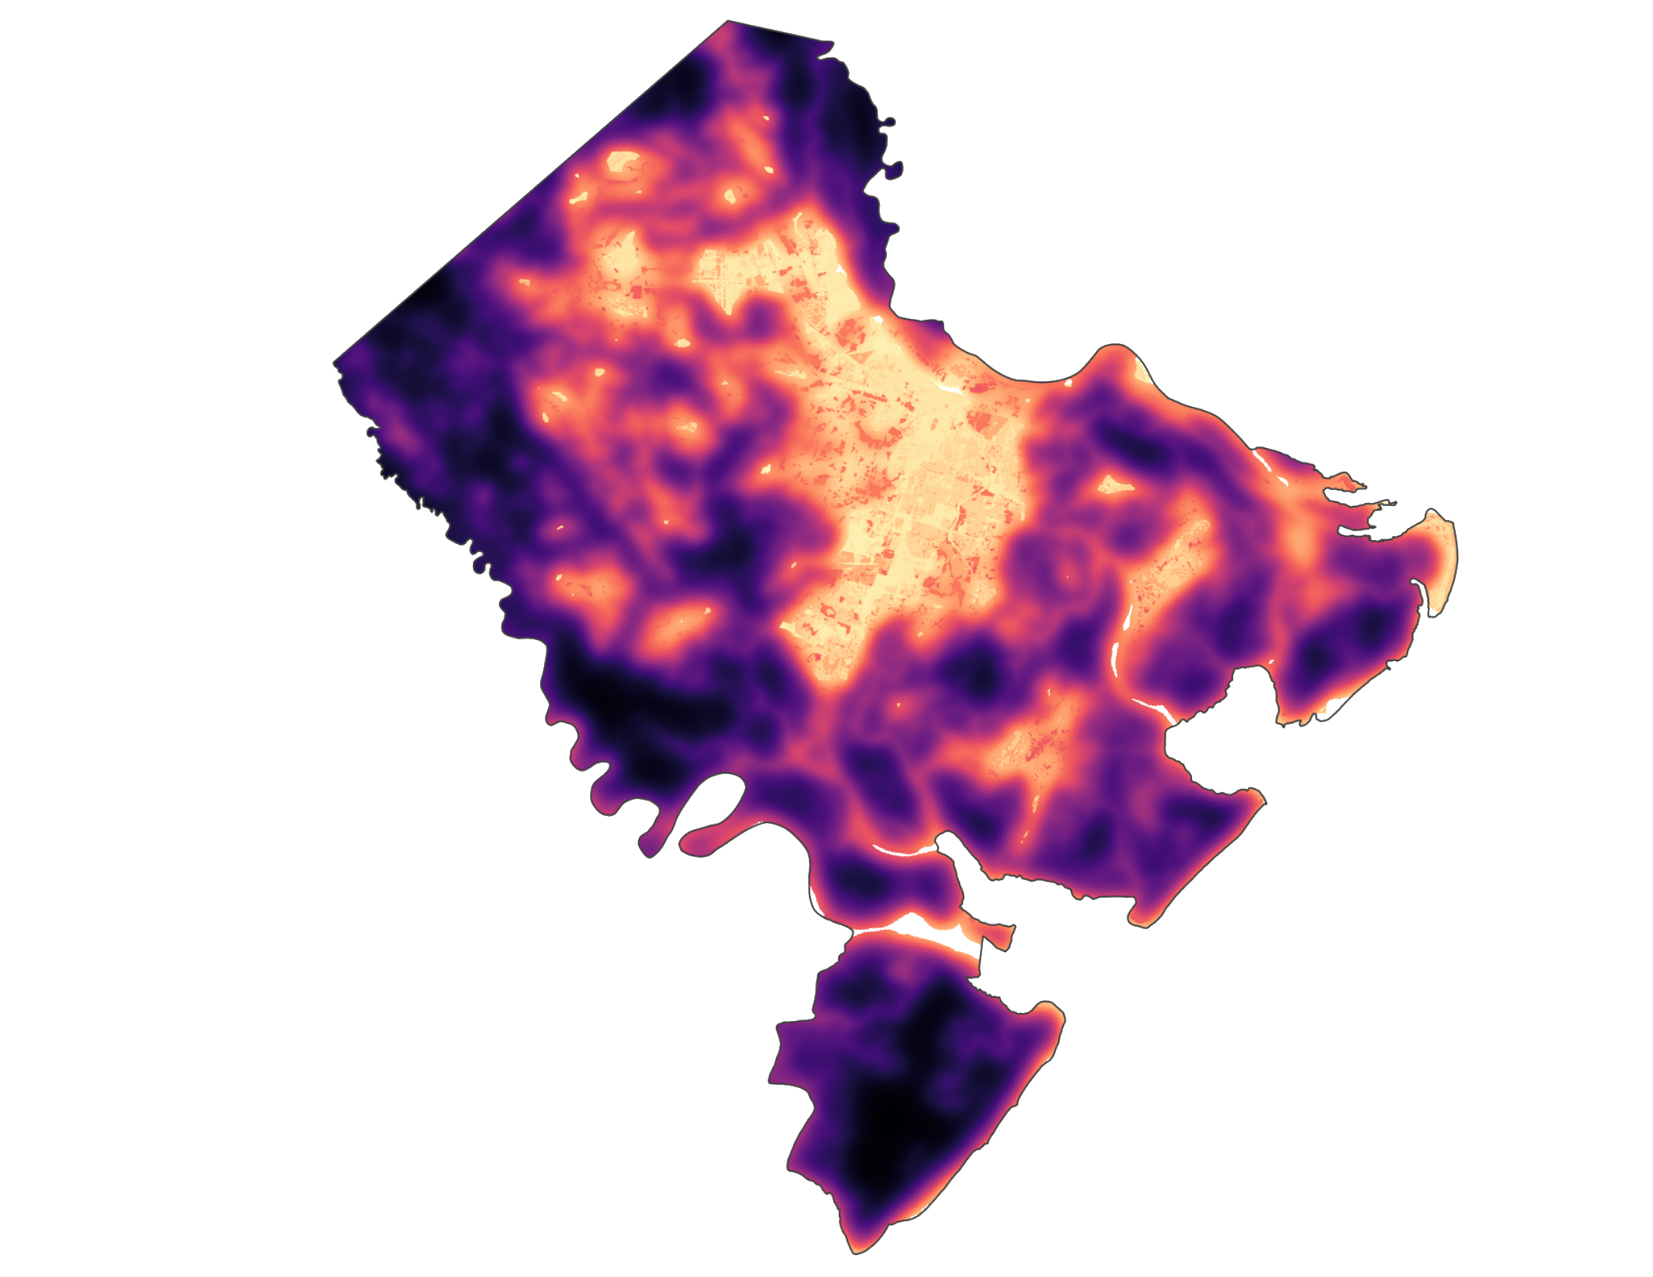















Chatham County Health & Air Quality
Mapping Urban Heat to Identify Priority Mitigation Areas in Chatham County, Georgia
Urban Heat Island Effect
How Can We Measure Urban Heat Island Impacts?
The Urban Heat Island (UHI) effect is a phenomenon where urban areas experience higher temperatures relative to nearby non-urban areas. The phenomenon is caused by:
High concentrations of impervious surfaces
Restricted airflow between buildings
Emissions that create heat domes
Landsat 8 OLI/TIRS
Landsat 9
OLI-2/TIRS-2
ISS ECOSTRESS
Heat Risk and Mitigation
We used Earth Observations to access land cover, land surface temperature, vegetation health, and canopy cover data to identify areas vulnerable to heat stress and to explore how heat vulnerability has changed spatially over time
The presence of UHIs is of concern both from a public health and climate perspective, having been linked to higher rates of heat related morbidity and mortality. Trees cool the urban environment by absorbing solar radiation, which provides both cooling shade and local heat-absorbing humidity through natural evapotranspiration.
InVEST Model of Chatham County
Our team used the InVEST Model to map Chatham County's ability to mitigate against heat stress based on factors outlined below. Areas with a low heat mitigation index are less able to cope with heat stress based on the modeled environmental factors.
Approximately 7,300 acres (~2% of the county) saw significant increases in Urban heat between 2014 and 2024.
Land Cover
Canopy Cover
2014 Canopy
2024 Canopy
31.8%
26.5%
Between 2014 and 2024, Chatham County lost approximately 17% of its existing canopy cover.
EXAMPLE
Heat Mitigation Index
Albedo
Earth observations of areas that underwent development between 2014 and 2024 showed signs of increased urban heat and decreased vegetation health.
High
Project Partner
Low
Evapotranspiration
Chatham County
Team Members
Acknowledgements
Partner: Jackie Jackson (Chatham County)
Science Advisors: Dr. Xia Cia (NASA Langley Research Center), Dr. Kenton Ross (NASA Langley Research Center)
DEVELOP Lead: Kathleen Miller (California – Ames)
Special Thanks: Maya Hall (California – Ames), Caroline Baumann (California – JPL)
Patrick O'Shea
Austin Lavorata
Ian Maywar
Sydney Pearce
Virginia – Langley | Spring 2025

